Slide 1



2024 Single Cell Workship Colombia: Day 4 10X pre-amplification, library prep, QC
July 15-19, 2024
Bogota, Colombia

Slide 2
Objectives for Today
Honeycomb CLX
10X Genomics
Done!
Recovery beads post-incubation
pre-amplification PCR
Spri clean up
Sample indexing + PCR
Spri clean up
Library QC

Slide 3
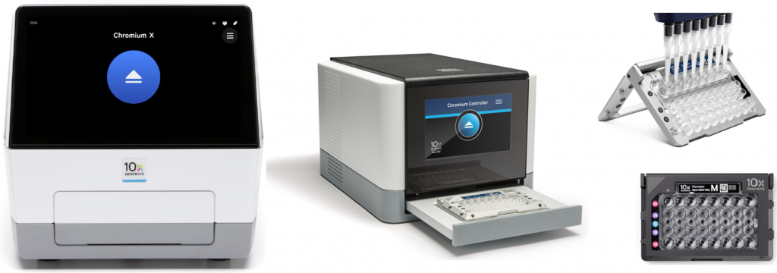
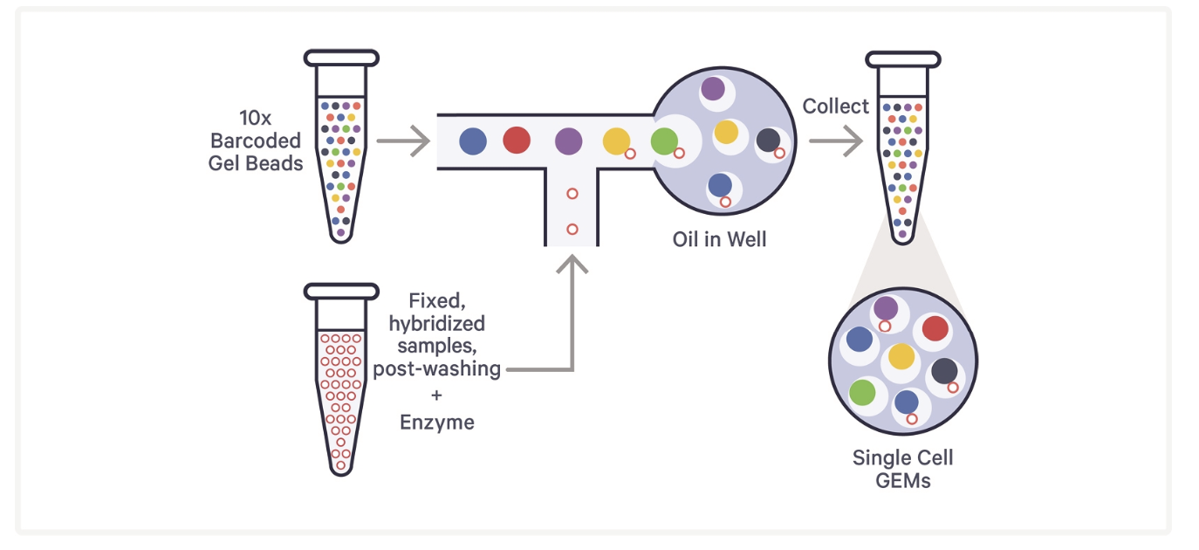
Yesterday: Chromium Fixed RNA Profiling–Cell Loading
Notes:
GEMs (Gel Bead-in-Emulsion): Released in solution Cell Preparation: Fixed cells with hybridized probes are prepared in a suspension with a high viability percentage (>80%) to ensure accurate capture. The cells must be well-dissociated to avoid clumping, as single-cell isolation is crucial for the process.
Microfluidic Partitioning: The cell suspension is loaded onto a microfluidic chip, which is part of the 10x Chromium Controller. The controller uses microfluidics to partition individual cells into oil droplets.
Gel Bead-in-Emulsion (GEM) Formation: Each oil droplet contains a single cell along with a barcoded gel bead. These gel beads are preloaded with oligonucleotides that include a unique barcode sequence, a poly-dT sequence for mRNA capture, and a template switching oligo (TSO).
Cell Lysis and mRNA Capture: Once the cells are partitioned into droplets, cell lysis occurs within each droplet, releasing the mRNA. The poly-dT sequence on the gel bead oligonucleotide captures the polyadenylated mRNA molecules.
Reverse Transcription and Barcoding: The TSO helps initiate reverse transcription, converting mRNA into cDNA while incorporating the unique barcode. This barcode tags all cDNA from the same cell, allowing for the identification of the cell of origin during sequencing.
Library Construction: The barcoded cDNA is then amplified, fragmented, and prepared for sequencing. Sequencing: The prepared libraries are then sequenced using high-throughput sequencing platforms, typically from Illumina. The resulting data includes reads that can be traced back to individual cells thanks to the unique barcodes.
Data Analysis: Bioinformatics tools, such as the Cell Ranger pipeline provided by 10x Genomics, are used to process the sequencing data. These tools demultiplex the reads, align them to a reference genome, and quantify gene expression and V(D)J sequences.

Slide 4
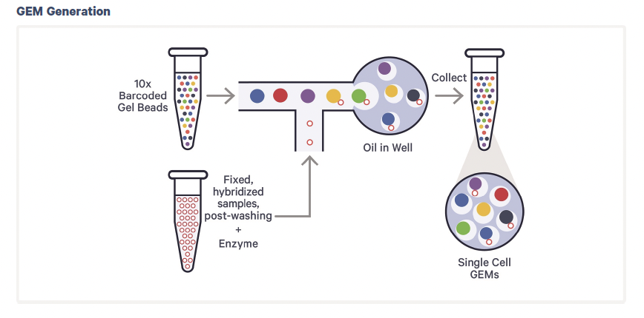
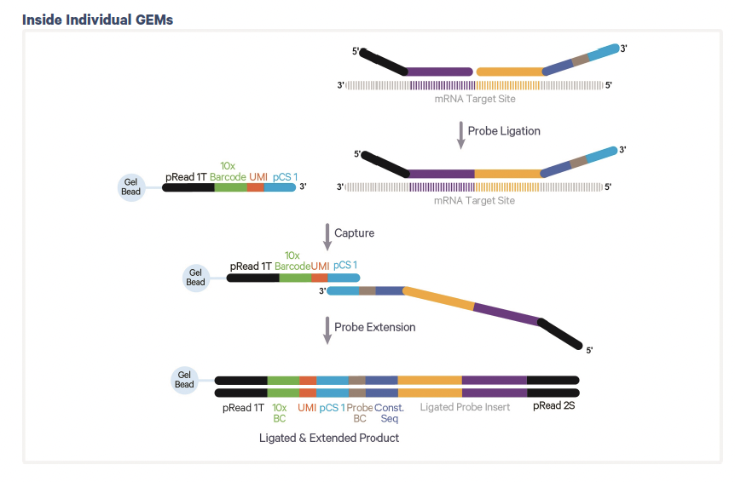
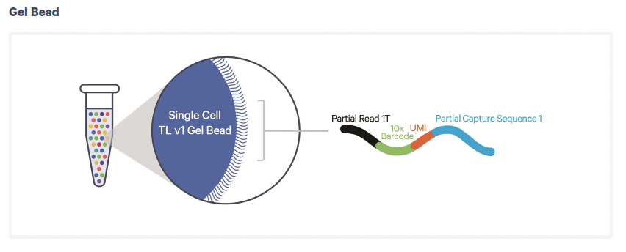
Yesterday: Chromium Fixed RNA Profiling GEM Generation

Slide 5
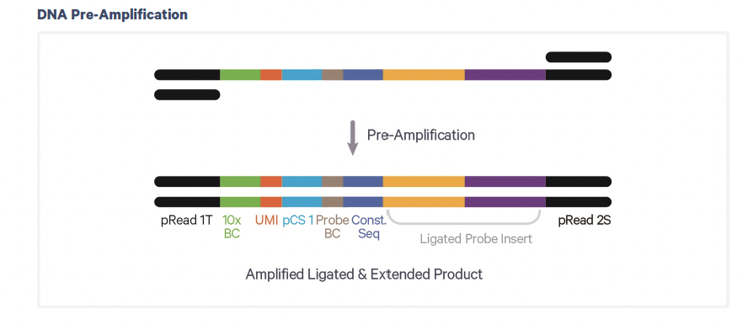
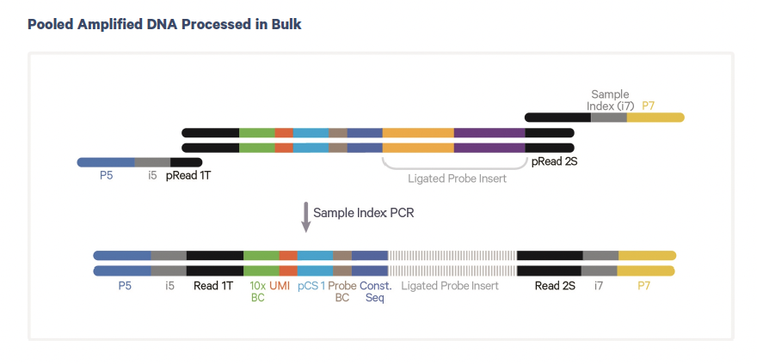
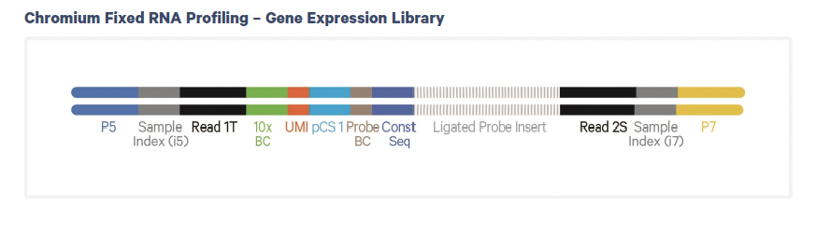
Today: Pre-Amplification, Library prep

Slide 6
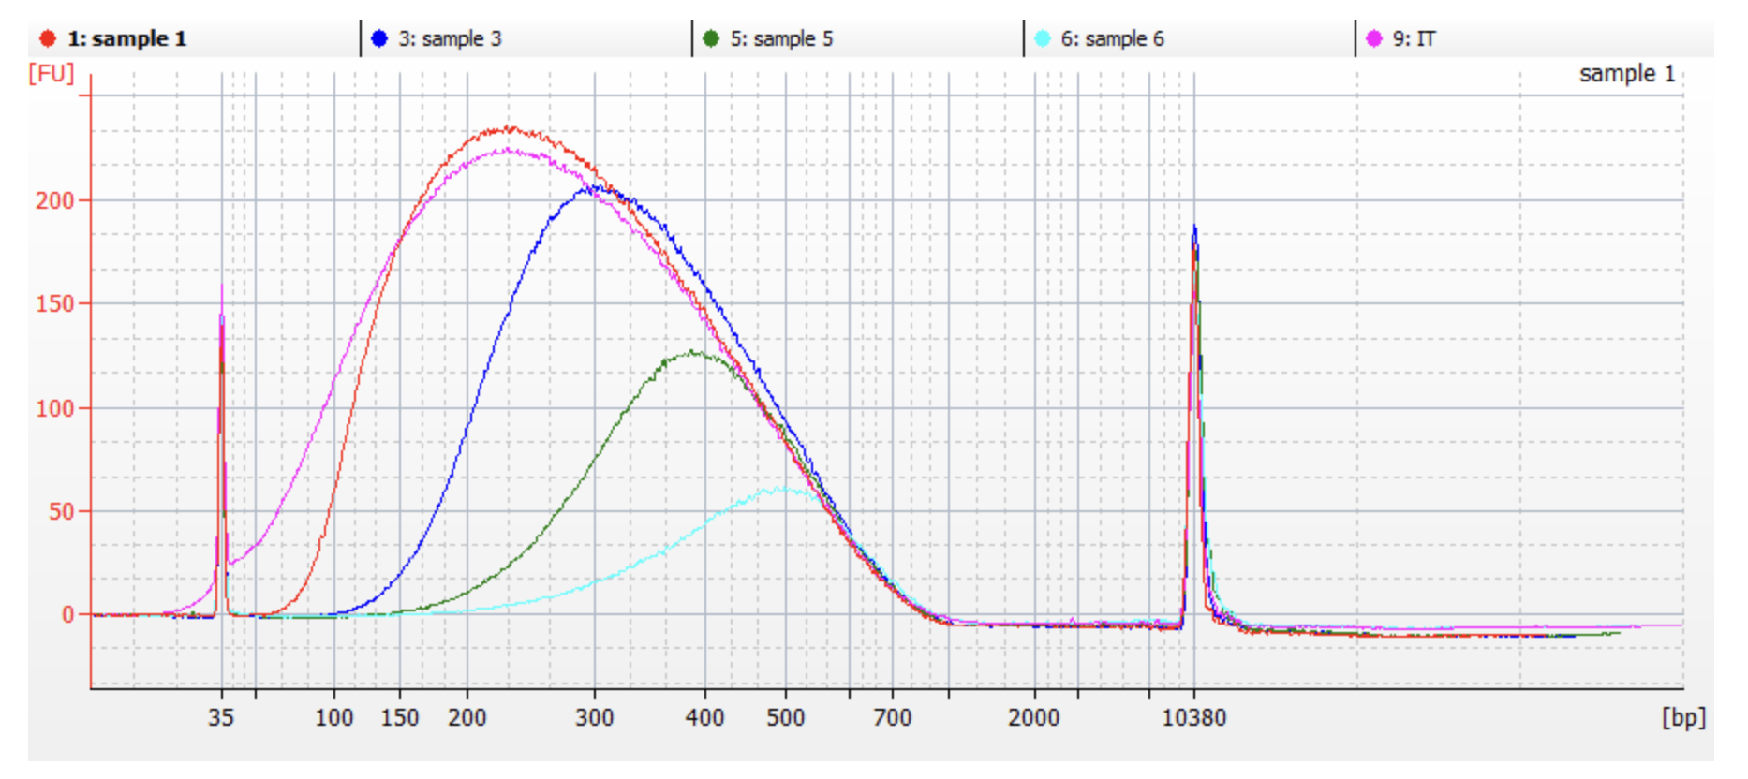
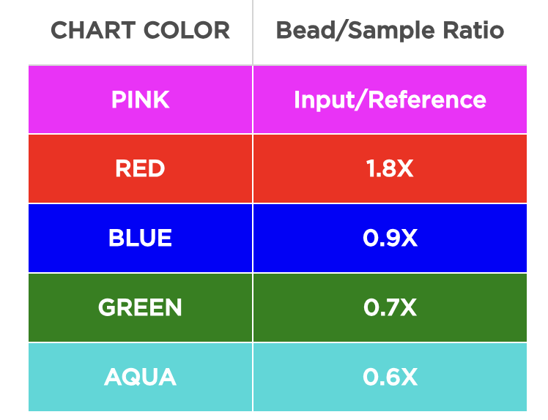
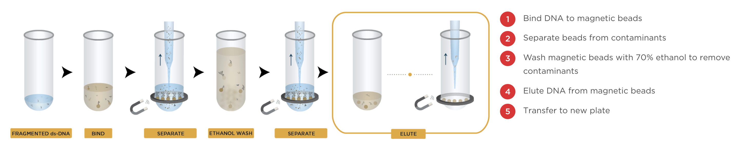
DNA Cleanup

Slide 7
Protocol Steps

Slide 8
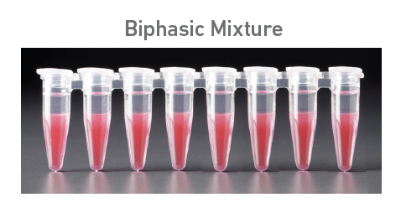
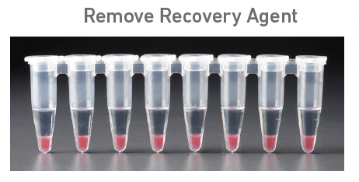
Today: GEM recovery

Slide 9
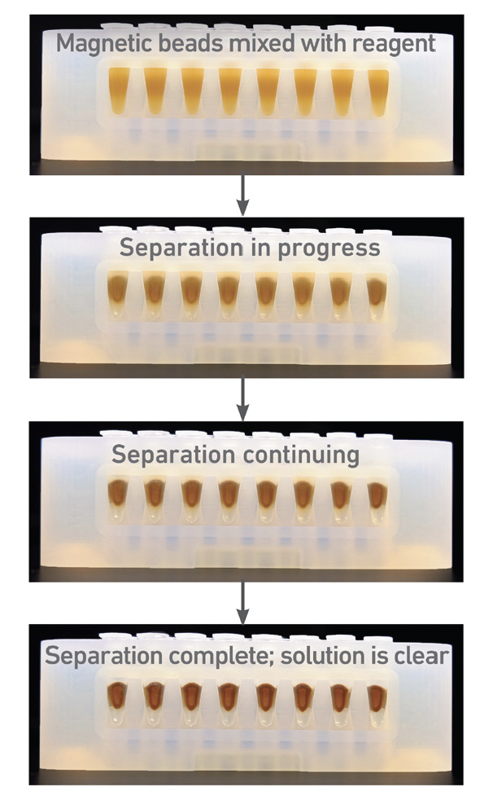
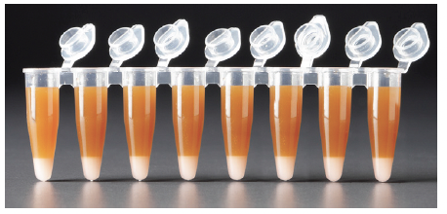
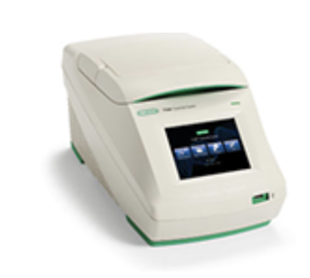
Today: Pre-amplification PCR + cleanup

Slide 10
Today: Index PCR + cleanup

Slide 11
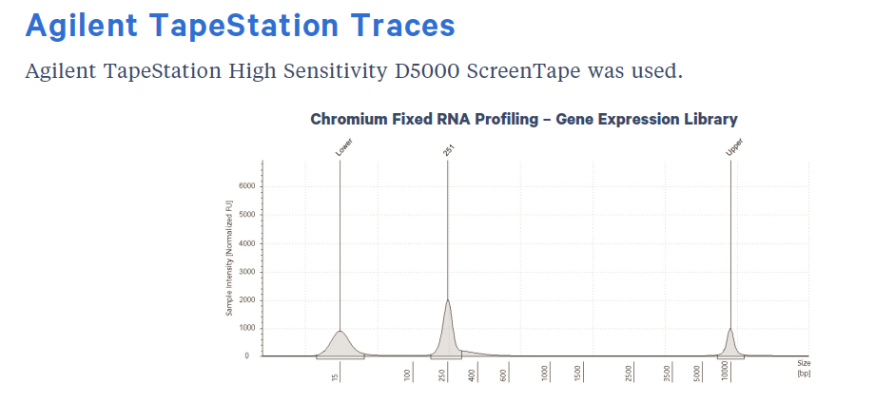
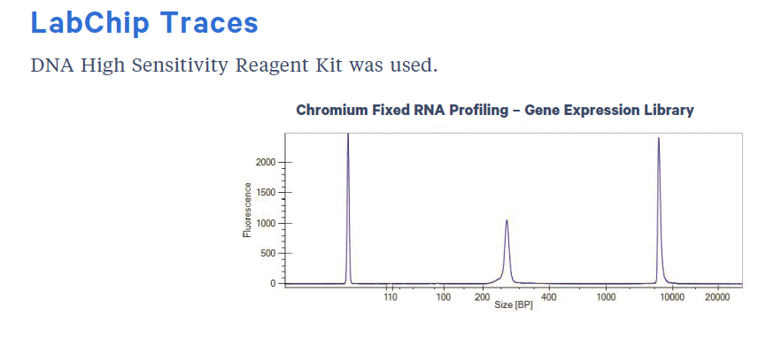
Quality Control

